Slide 1
The Jonah Project

Slide 2
At-Risk
Teens in Spokane
1. 1500+
2. Spheres of Influence & relationships
Freedom…& leverage-free resources
SHELTER & ADVOCACY

Slide 3
Trafficking
11-12 / 15*
2003 / 2008 / 2014?
2017 we have advocated for more than 120 women and children and 40+ victims of human trafficking – 90% from the Spokane area
500-600 / 1500-2000?
1500+ homeless?
1 in 3 / 1 in 5…

Slide 4
The Jonah Model
REST. RESOURCES. RELOCATION.
1. Relocation & Rescue
2. Secure/safe housing
3. Education & Awareness
4. ADVOCACY

Slide 5
Who is JP?
Relational & Collaborative
CIS, Shaw,Rogers, NC, Life Services, The City of Spokane, The Bridge, LifeCenter, Real Life, Spokane Human Right Commission
Volunteer
501c(3) Non-Profit
Freedom
Christian Ministry, Leverage-Free Resources

Slide 6
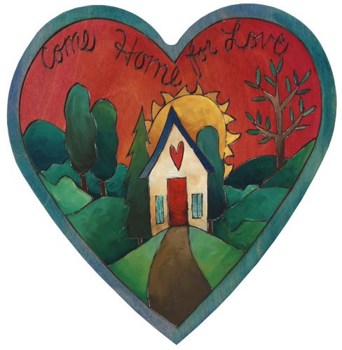
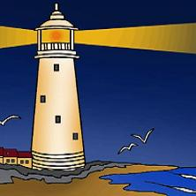
Heart House & LightHouse
24 HR
509.655.7886

Slide 7
Volunteer Opportunities
1-on-1 Advocates & House Leaders
Facilities & Maintenance on safe homes
Donation Center & Events
jonahproject.org
facebook.com/jonahproject.org

Slide 8
Thank You!
jonahproject.org

